Slide 1
Module 1:
The position of self-financing tertiary
education programmes in Hong Kong
June 2014
Federation for Self-financing Tertiary Education

Slide 2
Recap of the 1st Session
What is education?
Funding of Education
Magnitude
How to classify education?
Formal
Non-formal
Informal
Three approaches of educational planning :
70:20:10 Learning Theory
Social demand
Manpower planning
Rates of return
As % of total government expenditure
As % of GDP

Slide 3
Focus of the Session
The position of the Self-financing Tertiary Education (STE) sector
The challenges: strengths-weaknesses-opportunities-threats
A brief introduction to New Senior Secondary Curriculum (NSSC) and Hong Kong Diploma of Secondary Education (HKDSE)

Slide 4
Formal Education System
Every government generally will have its own education system through legislation under the generic three tiers framework:
primary
secondary and
tertiary

Slide 5
Education related Ordinances
279 | Education | Governing schools and institutions from KG to degree
320 | Post Secondary College | Governing institutions offering self accredited degree programmes
493 | Non-local, Higher and Professional Education (Regulation) Ordinance
1150 | Hong Kong Council for Academic Accreditation and Vocation Qualifications (HKCAAVQ)
261 | Hong Kong Examination and Assessment Authority

Slide 6
UGC related Ordinances
1053 | University of Hong Kong
1109 | The Chinese University of Hong Kong
1141 | The Hong Kong University of Science and Technology
1075 | The Hong Kong Polytechnic University
1126 | The Hong Kong Baptist University
1132 | City University of Hong Kong
1165 | Lingnan University
444 | The Hong Kong Institute of Education

Slide 7
What is STE?
Any differences in status between FSTE institutions?
Self-financing arms of UGC institutions
Institutions registered under cap 320
Institutions registered under 279

Slide 8
What is the position of STE Sector?
As competitors of
To supplement
To complement
the government funded tertiary education sector

Slide 9
The search for positioning of STE Sector
Under the notion that all students should be provided opportunities to progress beyond secondary education if they so wish:
What are the learning needs of students?
What are the advantages and strengths of STE institutions that edge over UGC institutions?
How can STE Sector make use of their advantages and strengths?

Slide 10
Any cues from OECD document?
Equity in Education | Evaluation and Assessment Frameworks for Improving learning Outcomes | Migrant Education
Pathways for Disabled Students to Tertiary Education and Employment | Recognising non-formal and informal learning | School Leadership
Teacher Policy | Tertiary Review | Vocational Education and Training (VET) Learning for Jobs

Slide 11
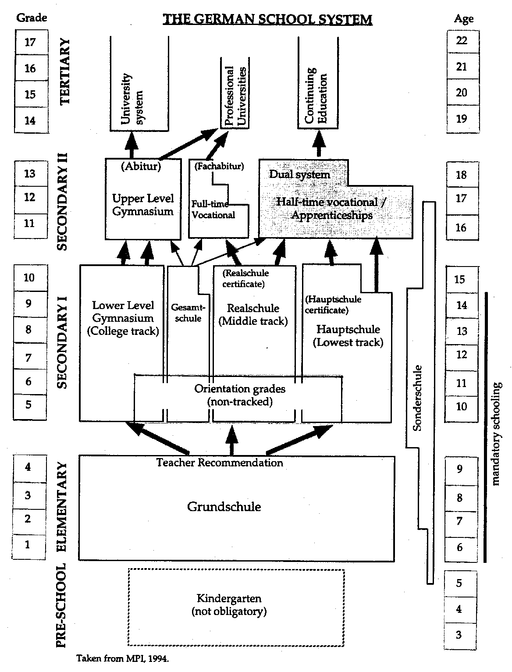

Slide 12
Discuss
Report back and
Share views

Slide 13
NSSC : The 7 Learning Goals
1 to be biliterate and trilingual with adequate proficiency
2 to acquire a broad knowledge base, and be able to understand contemporary issues that may impact on their daily life at personal, community, national and global levels
3 to be an informed and responsible citizen with a sense of global and national identity

Slide 14
NSSC: The 7 Learning Goals
4 to respect pluralism of cultures and views, and be a critical, reflective and independent thinker
5 to acquire information technology and other skills as necessary for being a life-long learner

Slide 15
NSSC: The 7 Learning Goals
6 to understand their own career/ academic aspirations and develop positive attitudes towards work and learning
7 to lead a healthy life-style with active participation in aesthetic and physical activies

Slide 16
From Primary Education to NSS Education
Core Subjects
Chinese Language,
English Language,
Mathematics,
Liberal Studies
(45-55%)
Elective Subjects 2-3 Elective Subjects chosen from 20 NSS elective subjects, Applied Learning courses and
other language courses
(20-30%)
Other Learning Experiences
Moral and Civic Education
Community Service
Aesthetic Development
Physical Development
Career-related Experiences
(15-35%)
Senior Secondary 2009
Generic Skills
Values &
Attitudes
P1- S3
General Studies
Moral and Civic Education
Physical & Aesthetic Development
Career-related Experiences
Intellectual Development
Community Service

Slide 17
Core / Elective Subjects
Chinese Language Education | Chinese Language (core subject) Chinese Literature
English Language Education | English Language (core subject) Literature in English
Mathematics Education | Mathematics (core subject + two extensions)
 | Liberal Studies (core subject)
Personal, Social and Humanities Education | Chinese History Economics Ethics and Religious Studies Geography History Tourism and Hospitality Studies
Science Education | Biology Chemistry Physics Science (Integrated, Combined)
Technology Education | Business, Accounting and Financial Studies Information and Communication Technology Technology and Living Design and Applied Technology Health Management and Social Care
Arts Education | Music Visual Arts
Physical Education | Physical Education
Applied Learning | 6 Areas of Studies

Slide 18
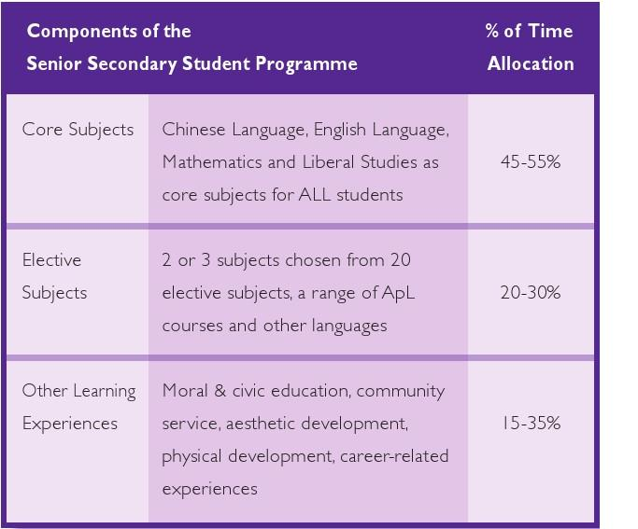

Slide 19
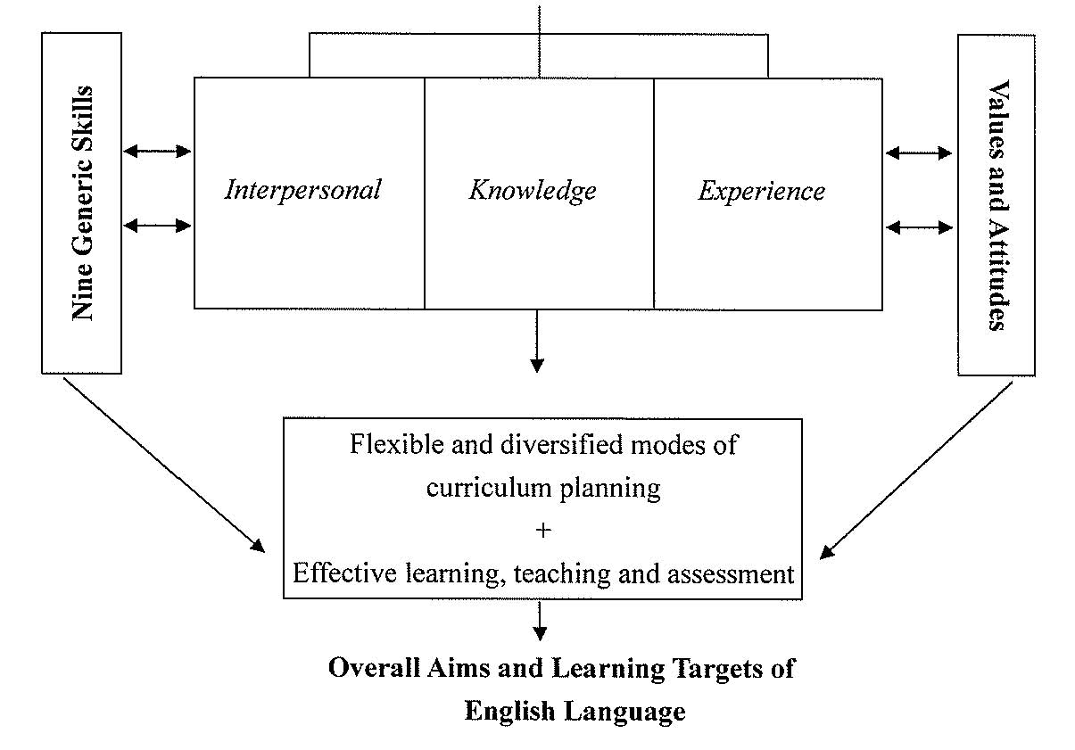
English Language

Slide 20
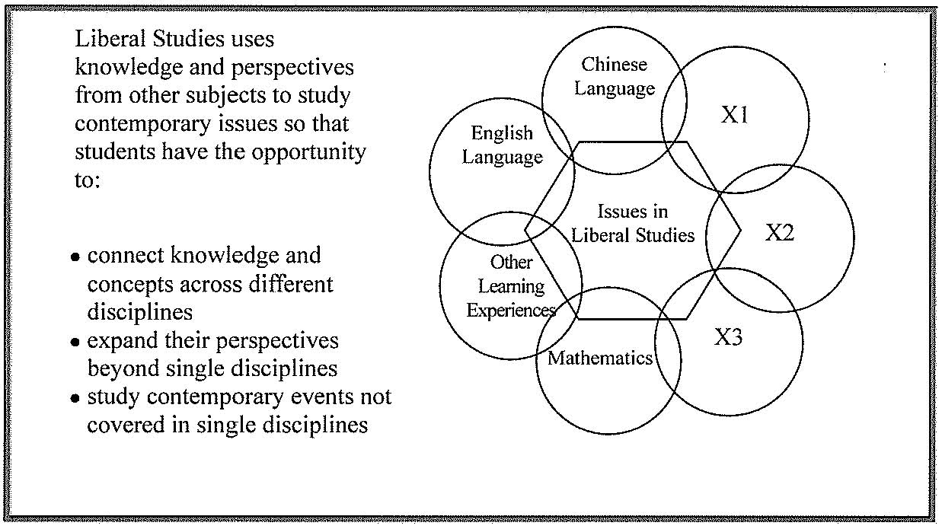
Liberal Studies

Slide 21
Liberal Studies
Areas of Study (all are core) | Independent Enquiry Study (IES)
Self & Personal Development Module 1: Personal Development & Interpersonal Relationships | In the IES, students make use of knowledge and perspectives gained from the Areas of Study and extend them to new issues or contexts. Suggested themes include: Media Education Religion Sports Art ICT
Society & Culture Module 2: Hong Kong Today Module 3: Modern China Module 4: Globalization
Science, Technology & the Environment Module 5: Public Health Module 6: Energy Technology & the Environment

Slide 22
Curriculum Framework of ApL
Life-long learning for further studies and/or work
Foundation Skills (e.g. communication skills, numeracy, information technology) | Thinking Skills (e.g. problem-solving & decision-making skills, analytical skills, creative thinking skills)
People Skills (e.g. self-reflection & self-management skills, interpersonal, collaborative & team building skills) | Values and Attitudes (e.g. honesty, responsibility, enthusiasm, willingness to learn, self-confidence, respect for others, law & authority)
Career-related Competencies (e.g. understand the related cluster of professions / trades / industries, future global & local outlook and develop related competencies through understanding the context of the course within the wider area of studies; understanding and interpreting the workplace requirements through practising the basic skill set in authentic or near authentic environment;and developing and applying conceptual, practical and reflective skills to demonstrate innovation and entrepreneurship)
Different Vocational Fields as Learning Contexts (e.g. Creative Studies, Media and Communication, Business, Management and Law, Services, Applied Science and Engineering and Production)
22

Slide 23
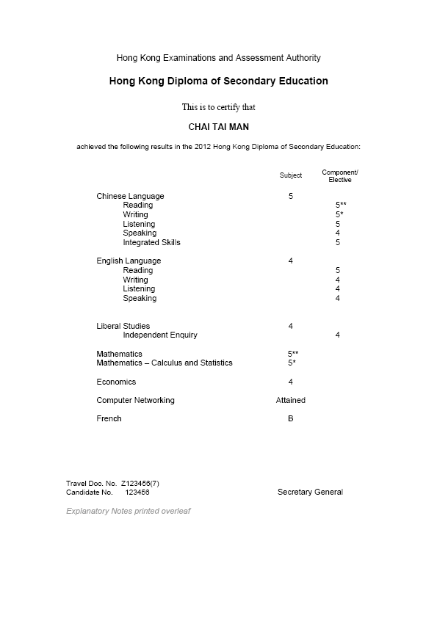
The HKDSE
Sample
Category
Core &
Elective
Subjects:
Performance Level
A
HKDSE
Results
Reporting
ApL Subjects:
Attainment Level
Practical Accounting for SMEs Attained with Distinction
B
Other Languages:
Grade
C

Slide 24
HKDSE: Reporting System
Category A | 24 NSS Subjects | Level 1-5, 5* and 5**
Category B | ApL Subjects | Attained and Attained with Distinction
Category C | Other Languages Subjects | Grade A-E
Other Learning Experiences |  | Student Learning Profile

Slide 25
What are your takeaway from this module?

Slide 26
Thank You!

